Slide 1
Retail Website Performance
Will smialek

Slide 2
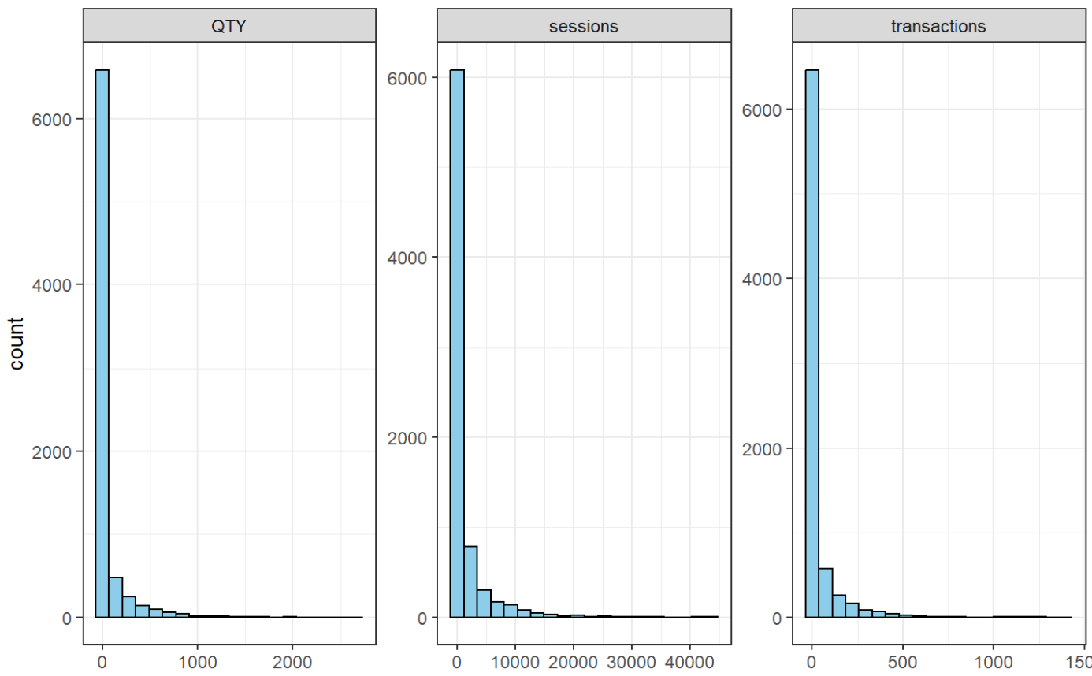
Exploratory Visualization
Data is heavily skewed right.
Some outlier days contain high levels of quantity, sessions, and transactions.
These days with heavy traffic are meaningful so they will not be removed.
Average rates are closer to the lower values for each feature.

Slide 3
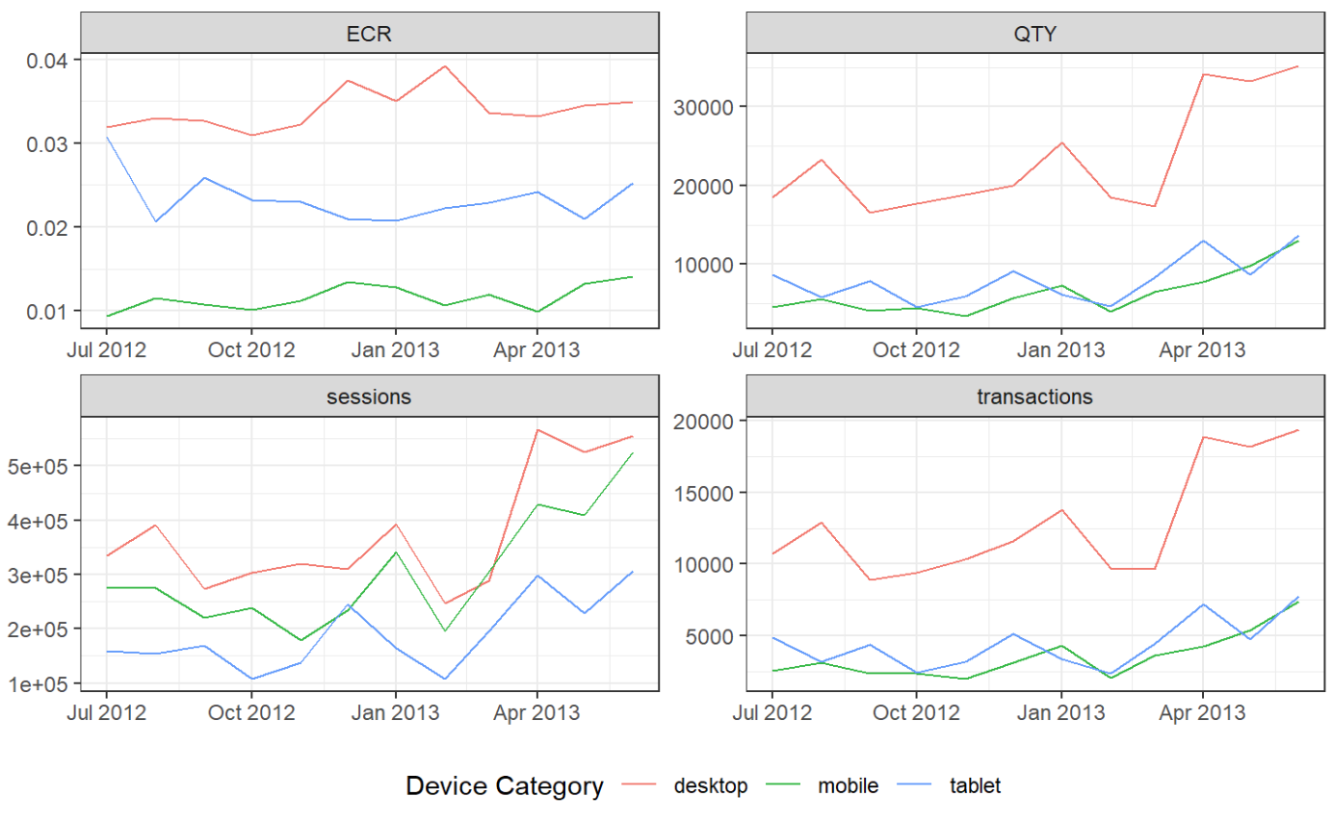
Aggregated Data
Main features are trending upwards.
ECR remains stable across time.
Users connecting via desktop are more lucrative.
Mobile users are the least likely to purchase something after connecting.

Slide 4
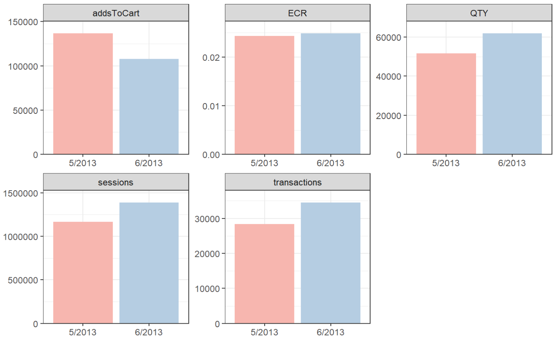
Recent Months Comparison
Decrease of 21% in number of adds to cart.
Significant increase in all other features.
+19% sessions
+22% transactions
+20% QTY
+2% ECR

Slide 5
Action Items
Optimize desktop experience.
Improve website design.
Upgrade functionality.
Enhance mobile experience.
Optimize website for mobile responsiveness.
Implement mobile-specific features to encourage conversions.
Monitor cart abandonment.
Offer incentives to complete purchases.
Streamline checkout process.

